Slide 1
Public Photography Contest With Live Voting

Slide 2
Contents
  Data Flow Diagram
  ER Diagram
  Data Dictionary
  Structural Chart

Slide 3
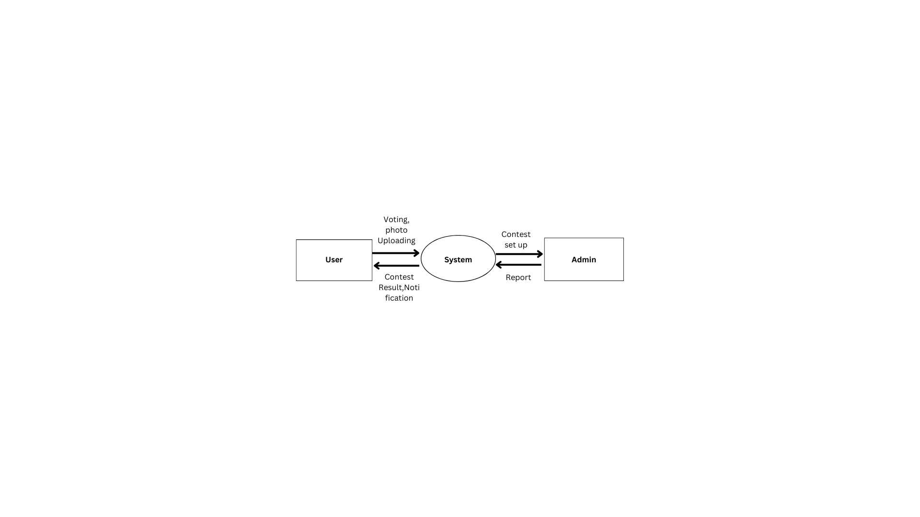
DFD Level 0

Slide 4
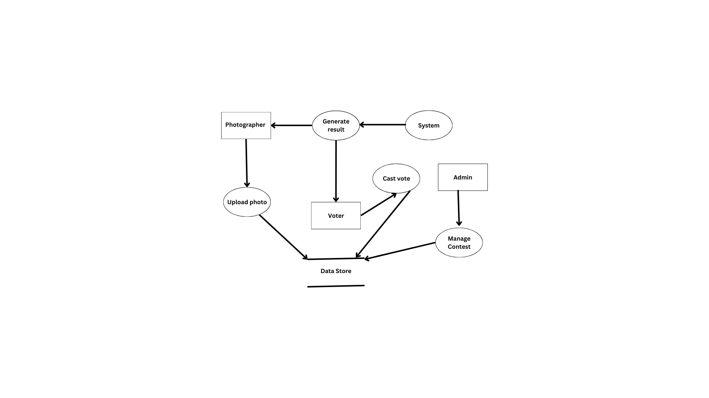
DFD Level 1

Slide 5
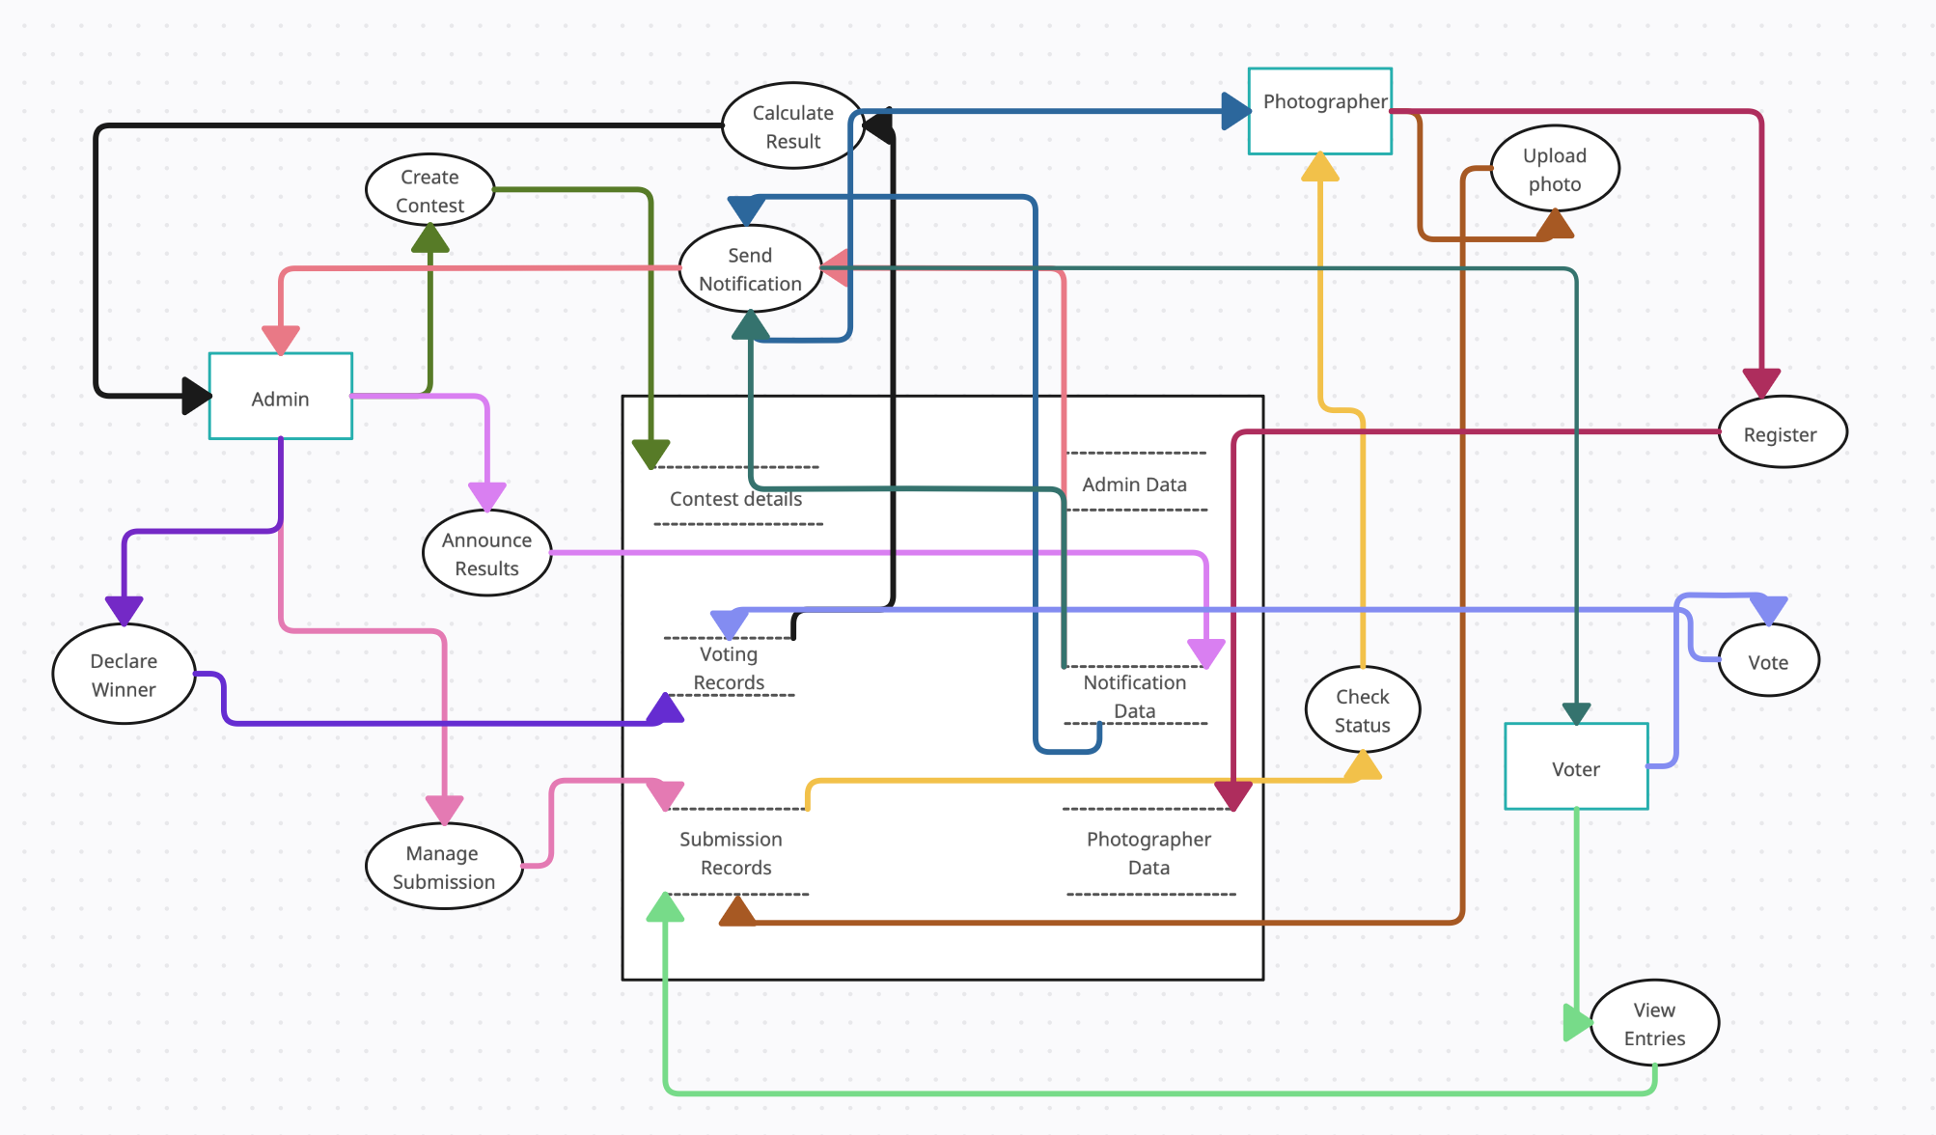

Slide 6
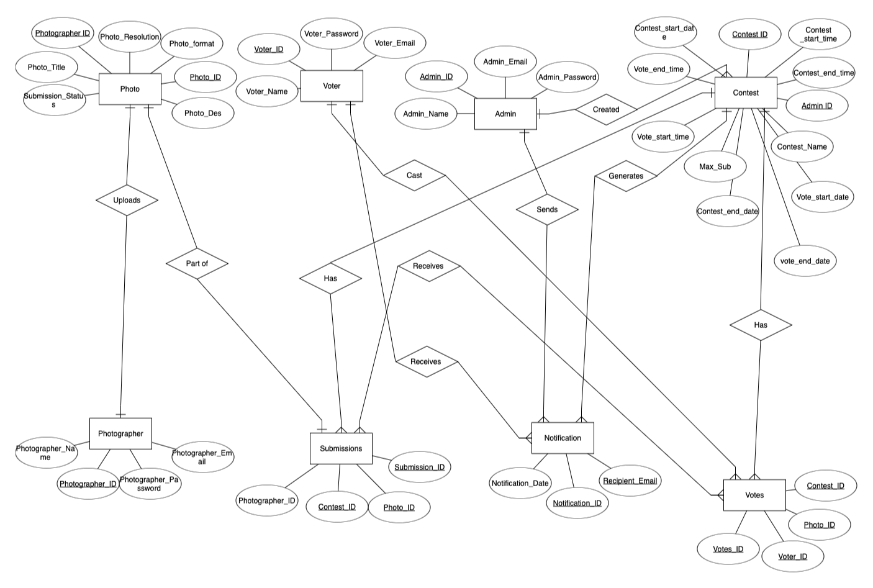
ERD

Slide 7
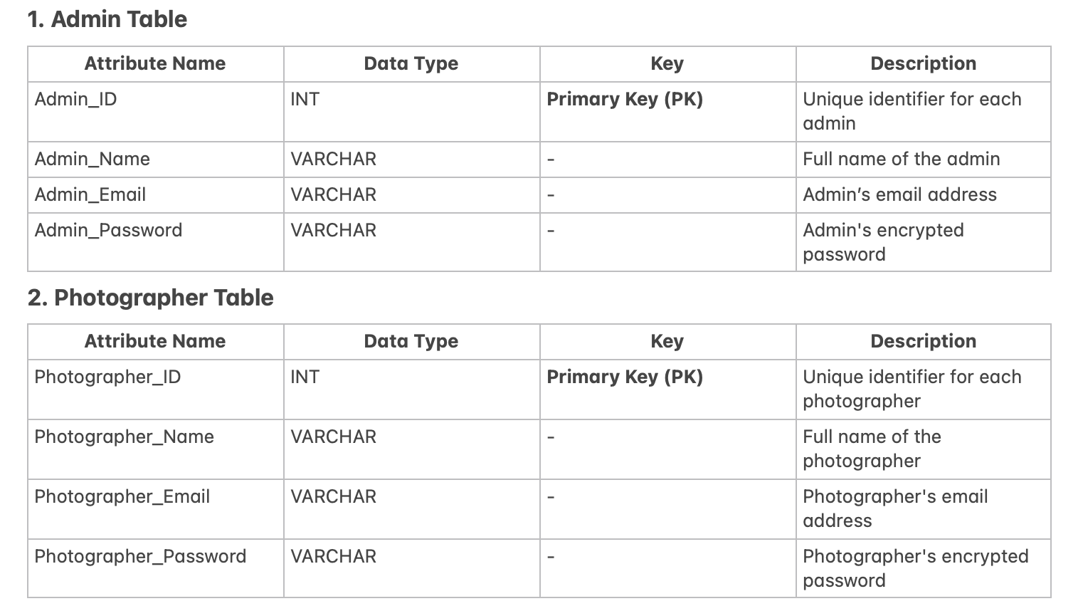

Slide 8
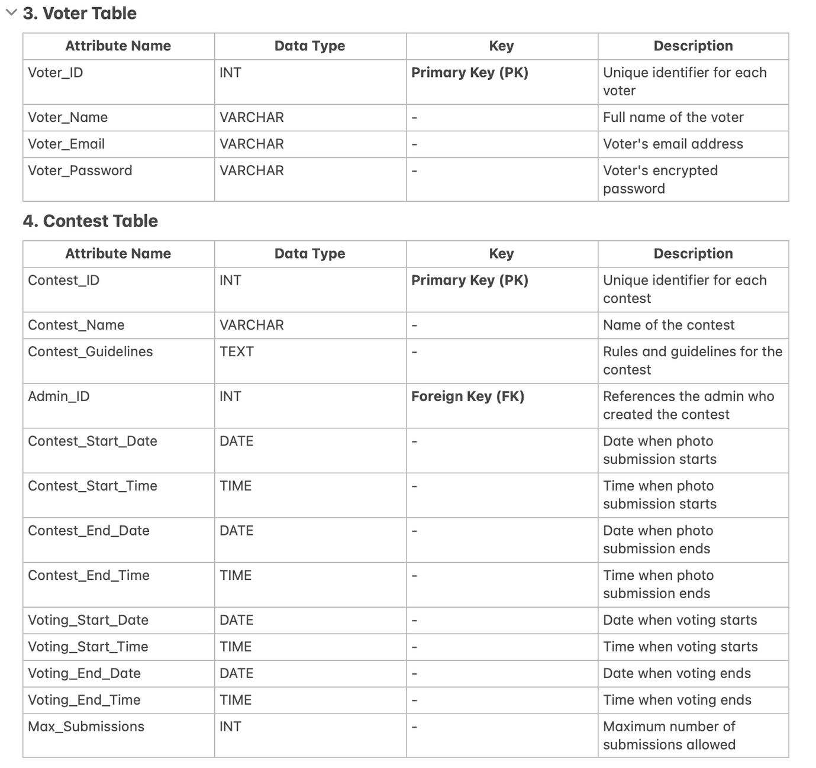

Slide 9
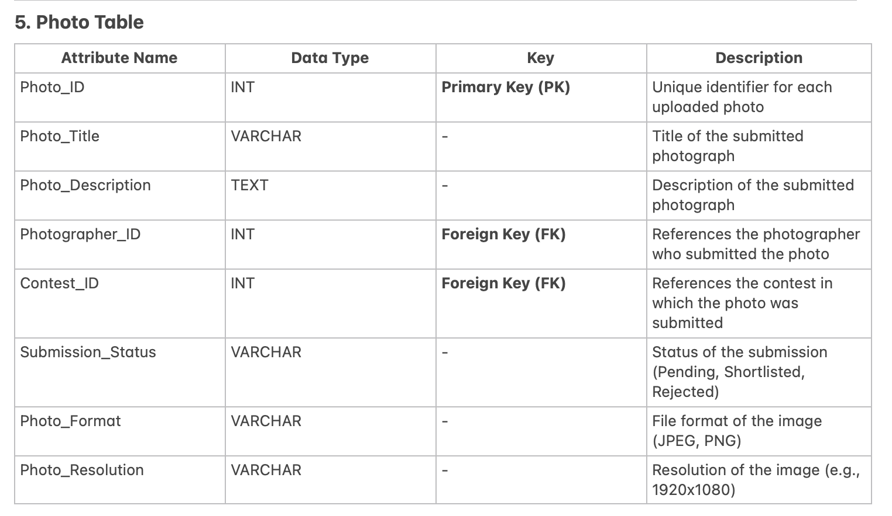

Slide 10
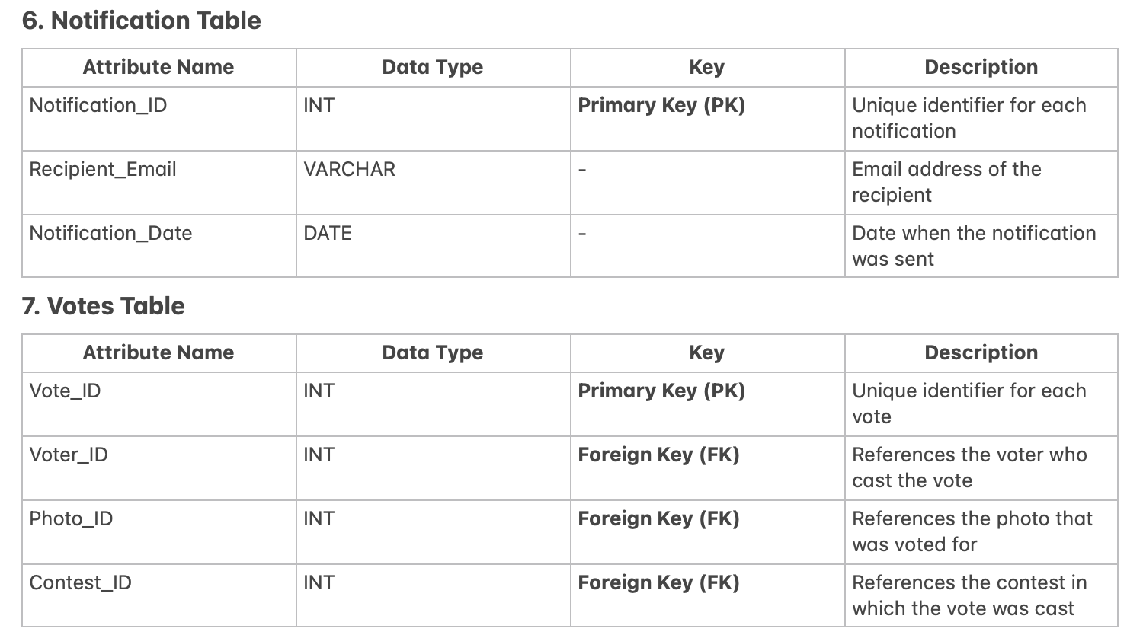

Slide 11
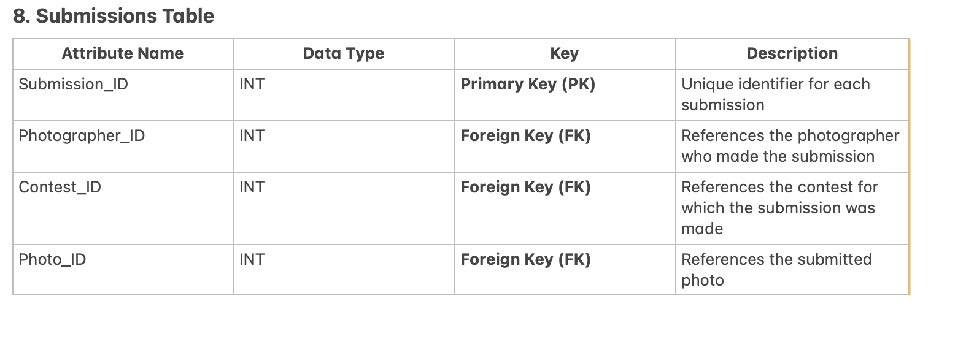

Slide 12
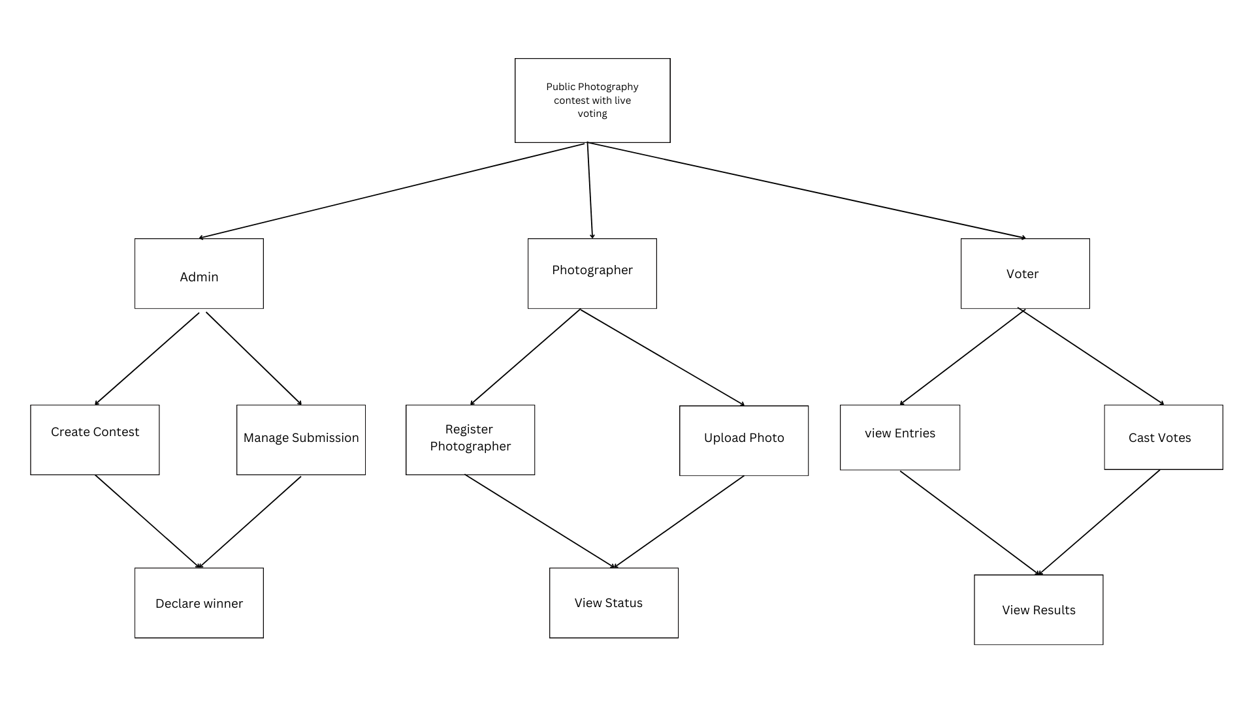
Structural Chart

Slide 13


